Slide 1
Wind Energy Conversion Systems
Muhammad Shamaas
2018-MS-EE-4

Slide 2
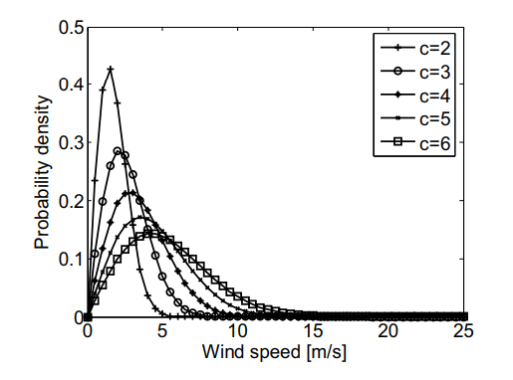
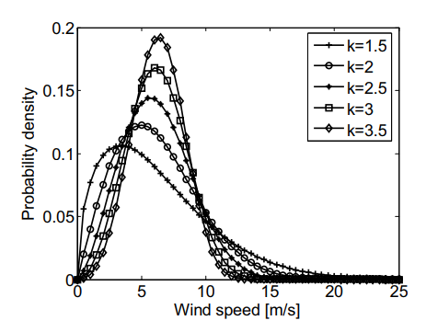

Wind Energy Resource
The Site Wind Speed can be modeled by Weibull distribution. The Average Wind Speed $v_{avg}$ increases with the Weibull distribution Scale Factor c and Shape Factor k.
$$v_{avg}=c.Γ(1+\frac{1}{k})$$

Slide 3
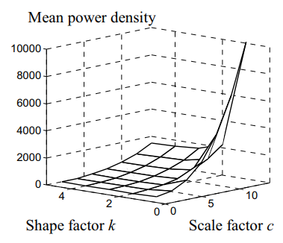
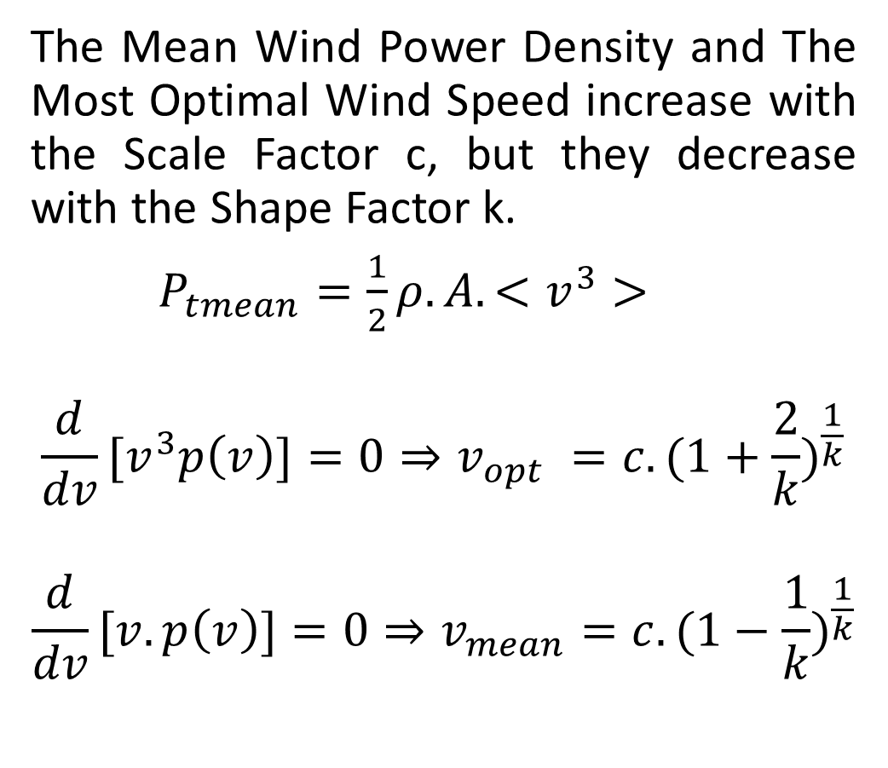
Wind Energy Resource
The Mean Wind Power Density and The Most Optimal Wind Speed increase with the Scale Factor c, but they decrease with the Shape Factor k.
$P_{tmean}=\frac{1}{2}ρ.A.<v^{3}>$
$$\frac{d}{dv}[v^{3}p\left(v\right)]=0⇒v_{opt} =c.{(1+\frac{2}{k})}^{\frac{1}{k}}$$
$$\frac{d}{dv}[v.p\left(v\right)]=0⇒v_{mean}=c.{(1−\frac{1}{k})}^{\frac{1}{k}}$$

Slide 4
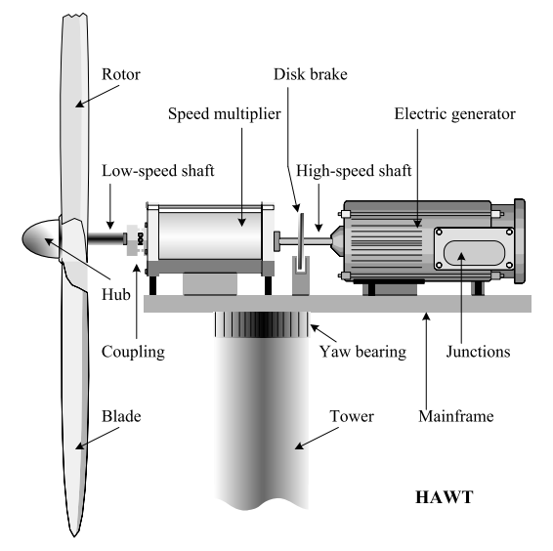
WECS Technology
Horizontal Axis Wind Turbine Energy Conversion Chain consists of:
Aerodynamic Subsystem (Turbine Rotor and Turbine Hub)
Drive Train (Low-speed shaft, Speed Multiplier and High-speed shaft)
Electromagnetic Subsystem (Electric Generator)
Electric Subsystem (Elements for Grid Connection)

Slide 5
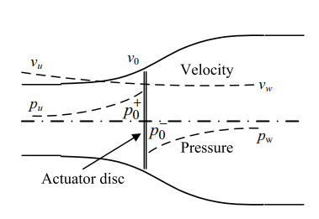
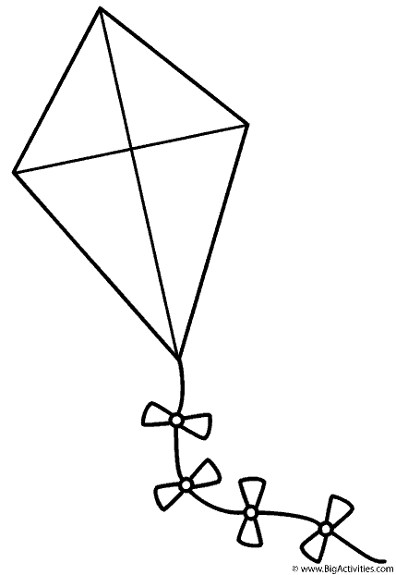
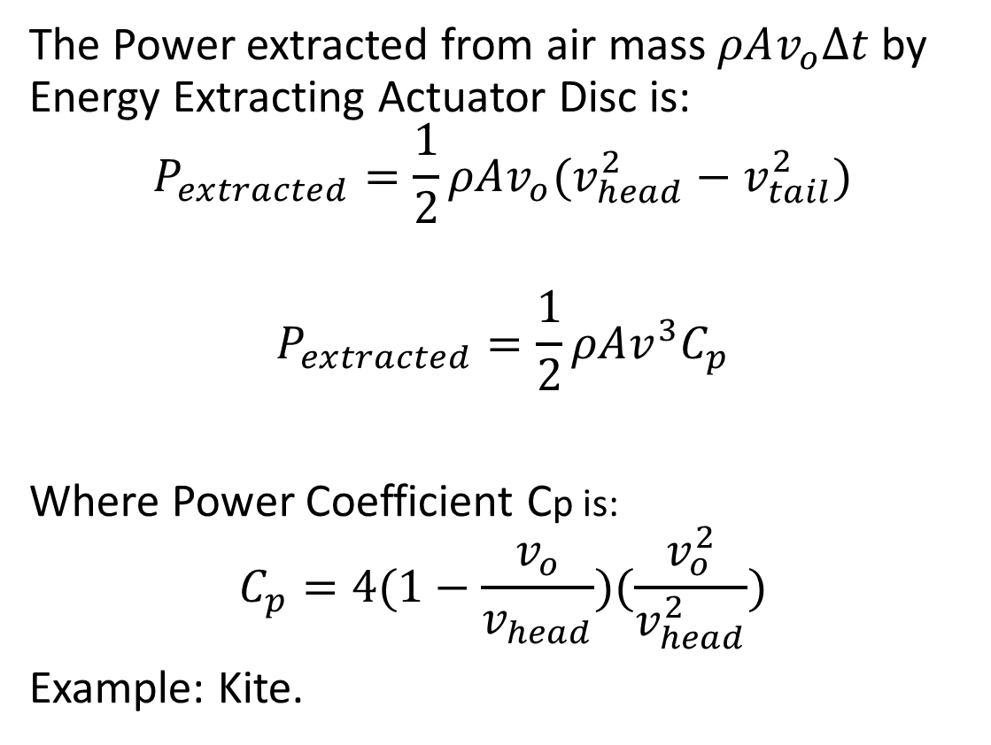
Wind Turbine Aerodynamics
The Power extracted from air mass $ρAv_{o}∆t$by Energy Extracting Actuator Disc is:
$$P_{extracted}=\frac{1}{2}ρAv_{o}(v_{head}^{2}−v_{tail}^{2})$$
$$P_{extracted}=\frac{1}{2}ρAv^{3}C_{p}$$
Where Power Coefficient Cp is:
$$C_{p}=4(1−\frac{v_{o}}{v_{head}})(\frac{v_{o}^{2}}{v_{head}^{2}})$$
Example: Kite.

Slide 6
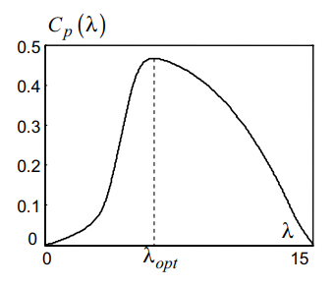
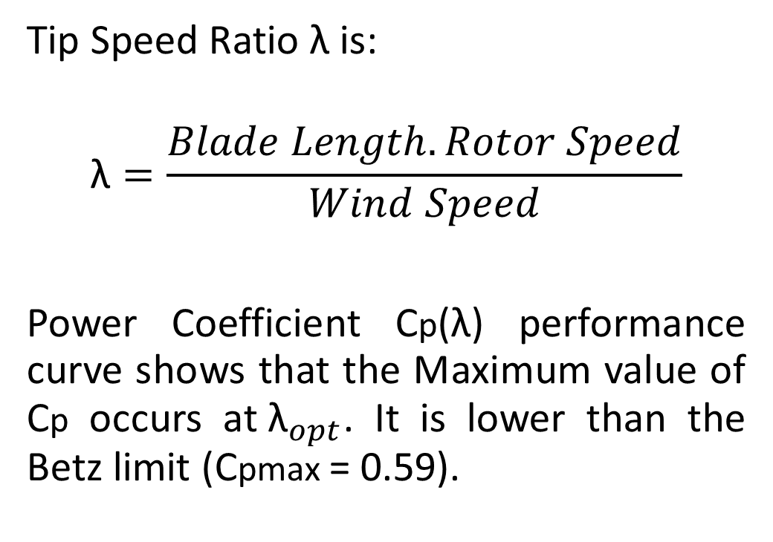
Wind Turbine Aerodynamics
Tip Speed Ratio λ is:
$$\text{λ}=\frac{Blade Length.Rotor Speed}{Wind Speed}$$
Power Coefficient Cp(λ) performance curve shows that the Maximum value of Cp occurs at${ \text{λ}}_{opt}$. It is lower than the Betz limit (Cpmax = 0.59).

Slide 7
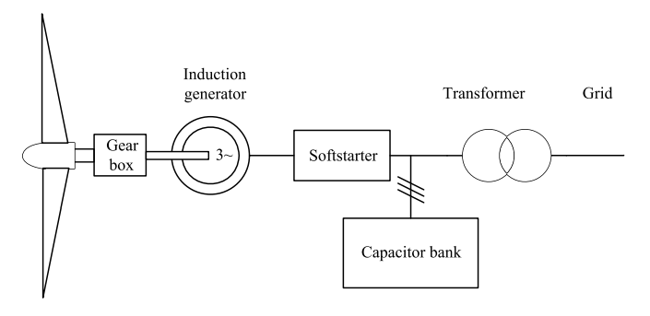
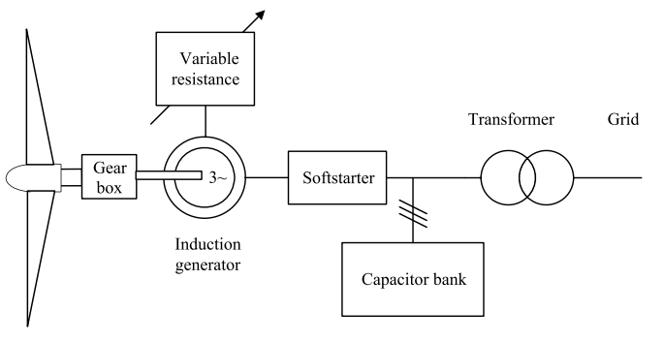
Power Generation System
Fixed-speed WECS:
General structure of a fixed-speed WECS (Squirrel Cage Induction Generator)
General structure of a limited variable-speed WECS (Wound Rotor Induction Generator)

Slide 8
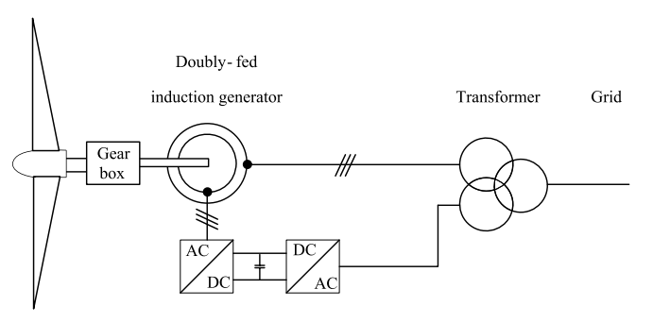
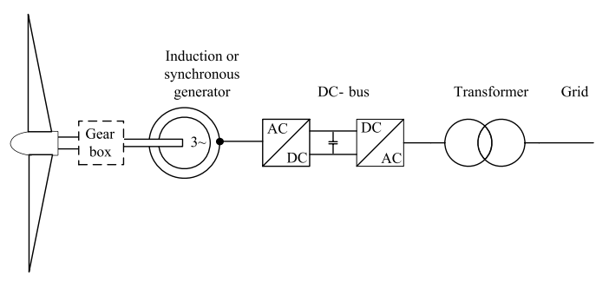
Power Generation System
Variable-speed WECS:
General structure of an improved variable-speed WECS (Doubly Fed Induction Generator)
General structure of a full variable-speed WECS (Squirrel Cage Induction Generator or Synchronous Generator)

Slide 9
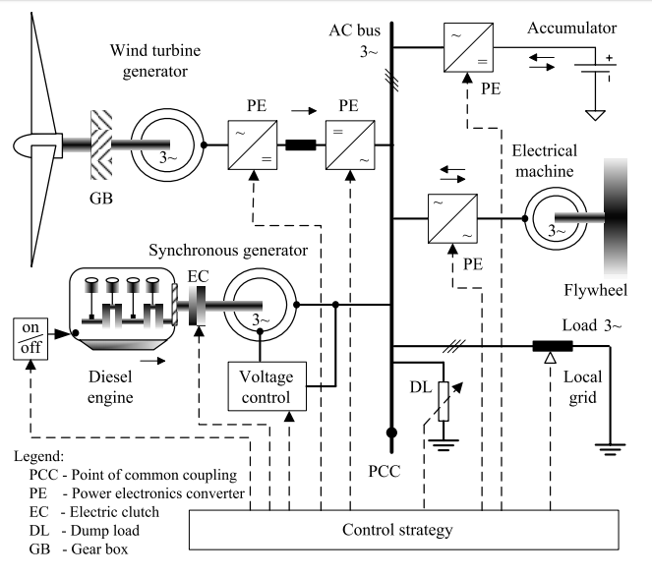
Wind Turbine Generators in Hybrid Power Systems
AC-coupled hybrid generation system:
Generators (Wind Turbine Generator, Diesel Power Plant)
AC Bus
Energy Storage (Accumulator, Flywheel)
Loads
Control System

Slide 10
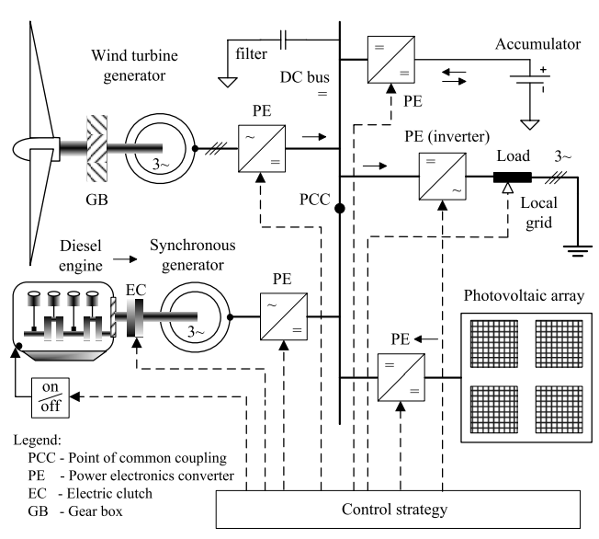
Wind Turbine Generators in Hybrid Power Systems
DC-coupled hybrid generation system:
Generators (Wind Turbine Generator, Diesel Power Plant, Photovoltaic Cells)
DC Bus
AC Filter
Energy Storage (Accumulator)
Loads
Control System

Slide 11
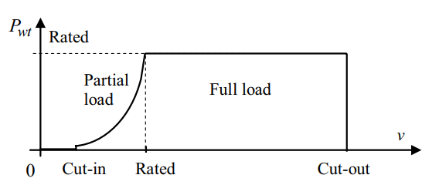
Control Objectives
Aerodynamic power control through pitch/ stall control
Variable-speed operation and energy capture maximization, by means of generator control.
Grid Power Transfer Control, through the power electronics converter.

